Slide 1
Gamma Ray and Anti-Matter Survey (GRAMS)
Power Distribution Unit (PDU)
Time Projection Chamber (TPC) SiPM Low Voltage Board

Slide 2
Agenda
The Power Distribution Unit (PDU) for GRAMS is extensive
Only reviewing the Low Voltage Board within the SiPM Box
Purpose of the Board
Block Diagram
Schematic Review
Grounding Configuration
Layout Review

Slide 3
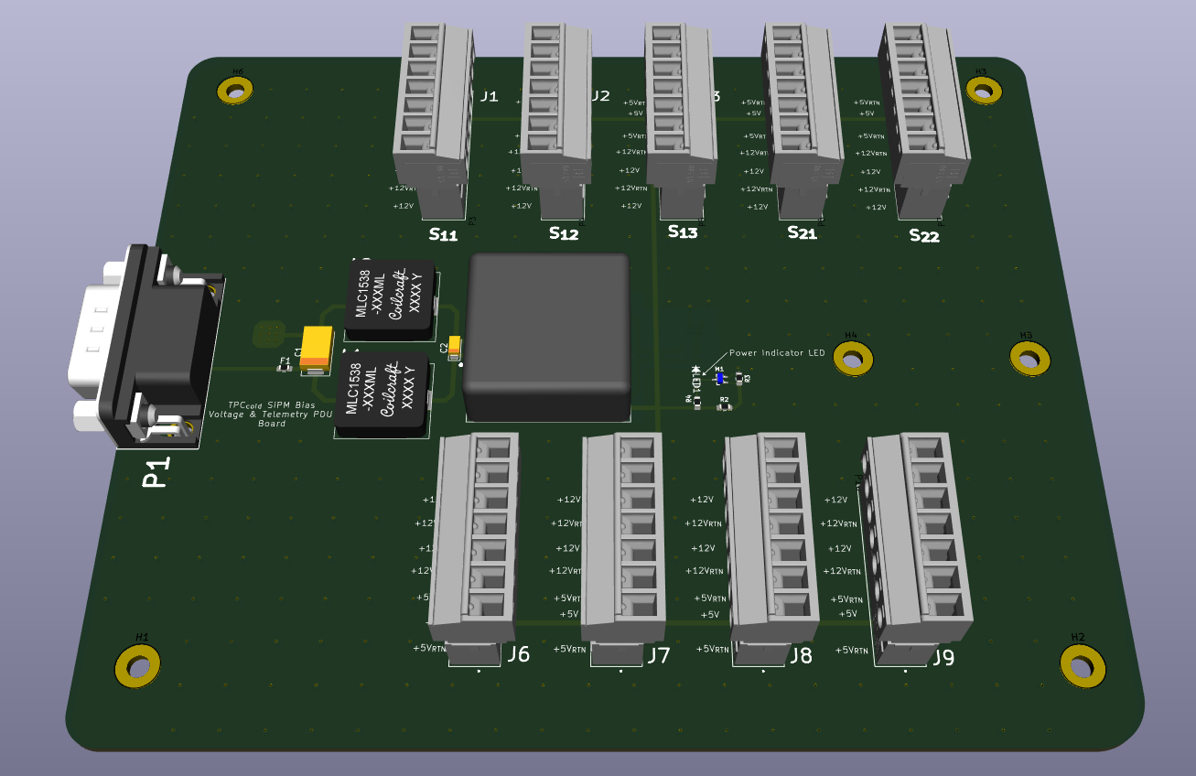
Board Power
Recalling from the SiPM Box, there is a board that is providing +5V and +12V for telemetry and drive for the on-board DC-DC Converters
This can be utilized to run the SiPM LV Board as well.

Slide 4
Block Diagram of TPC SiPM Box
The S₁ through S₆ along with the Telemetry PDU Board were reviewed previously
The SiPM LV Board will also reside in this box. This review is only pertaining to that box.
S₁
+12V_{IN}
+5V
=
+5V_{RTN}
6 SiPM
& SiPM LV PDU
+12V_{RTN}
=
S₆
SiPM LV Board

Slide 5
Schematic Review of SiPM LV Board

Slide 6
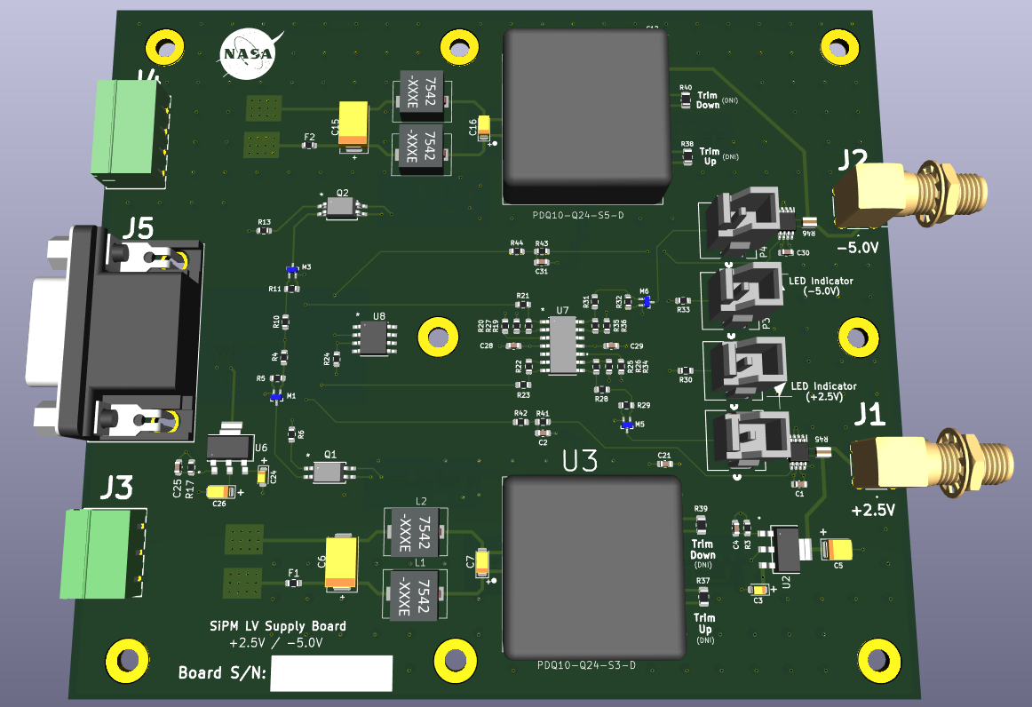
On-Board DC-DC Converters
The rails that this board provides to the cold SiPM preamplifiers are +2.5 / -5.0V
This is achieved by using two converters from the same family that provide different voltages.
PDQ10-Q24-S5-D (5V Rail)
PDQ10-Q24-S3-D (3.3V Rail)
Trim resistor pads are provided if that becomes a need
Output voltages are isolated.

Slide 7
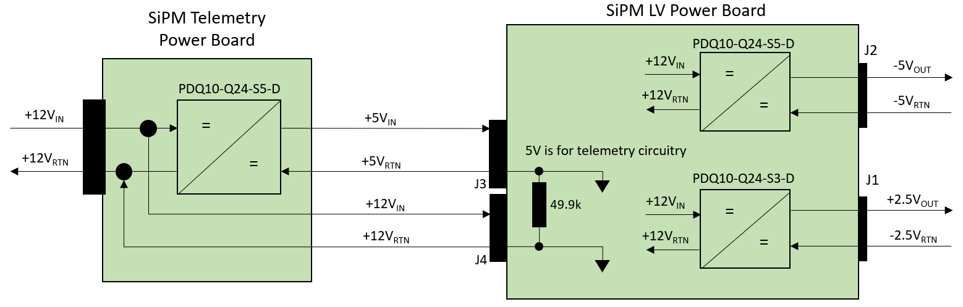
Power Rails
The SiPM LV Board receives +12V and +5V that drive the DC-DC Converters and Telemetry, respectively.
This diagram also shows the grounding configuration

Slide 8
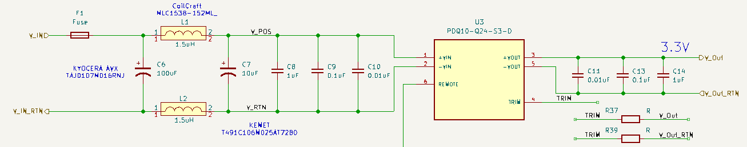
Input EMI/EMC Network
EMI/EMC Network is consistent with other designs that use the same CUI Converters of this class
Switching Frequency: 280kHz for all PDQ10-Q24’s
Input Network F_{C} = 29kHz, Z_{IN} = 0.55Ω
Z_{IN(U3)} = 80Ω

Slide 9
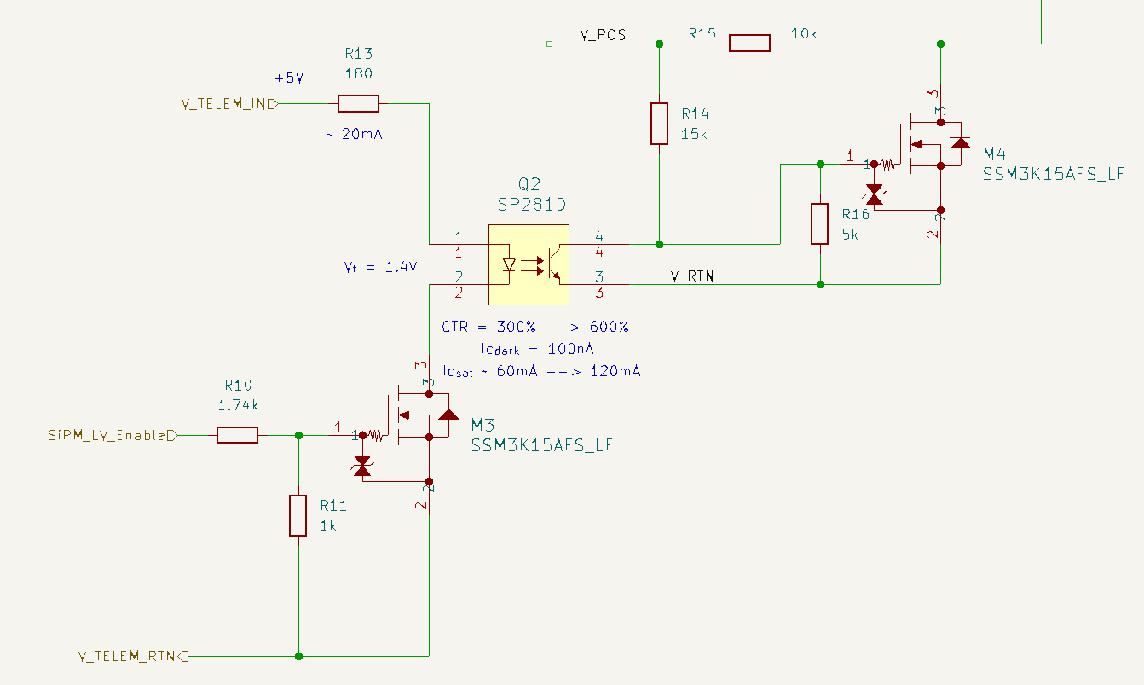
Enable / Disable Circuitry
PDQ10-Q24-S(x)-D Enable Signal
There is a 10kW Pull-Up resistor internal to the Converter that defaults the block to enabled if no external control circuitry is added.
Am using an opto-coupler to control this function
ISP281D:
Current Transfer Ratio (CTR): 300 to 600%
I_{D} = 100nA
I_{SAT} = 60 to 120mA
Truth Table
SiPM_LV_Enable | Low | High
Enable Line | Low | High
DC-DC Conv. | Disabled | Enabled

Slide 10
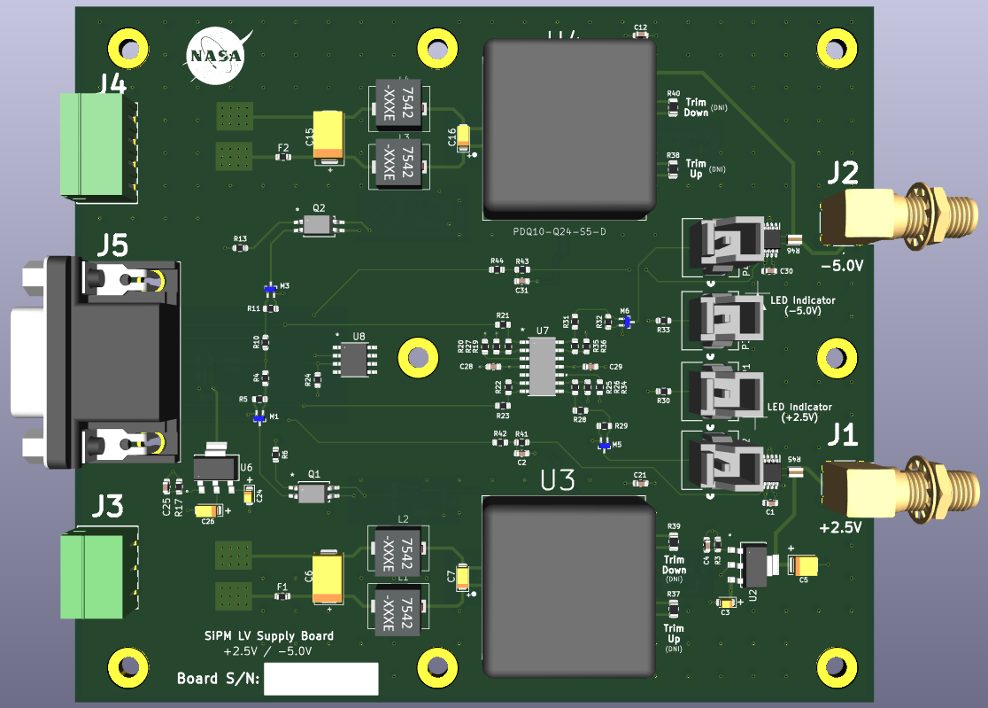
Telemetry Points
Telemetry points are output on J5 (15-Female, HD DSUB)
+2.5V Voltage and Current Monitor
-5V Voltage and Current Monitor
Temperature Monitor

Slide 11
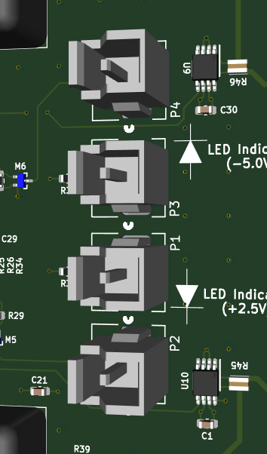
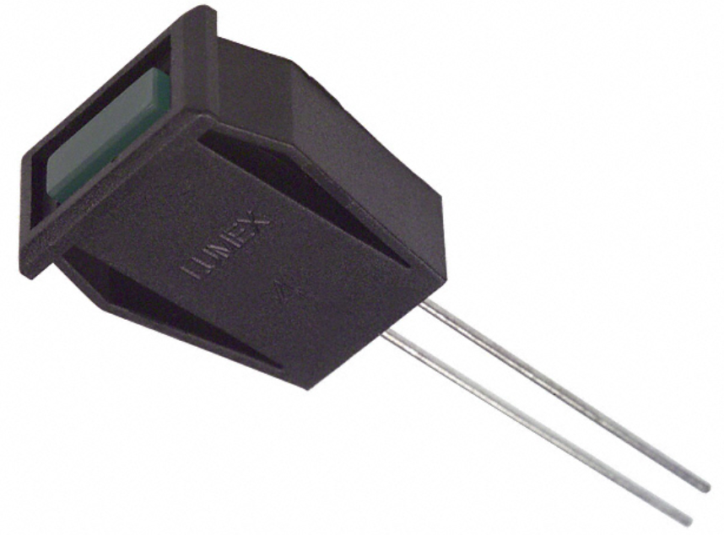
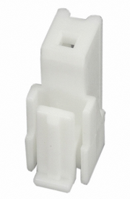
LED Indicator
1-1123824-1
Part Num: SSI-LXH072GD
1-1123823-1 mates to the 1-1123824-1
Easy to mate and de-mate
Mounted on Chassis

Slide 12
Layout Review of SiPM LV Board

Slide 13
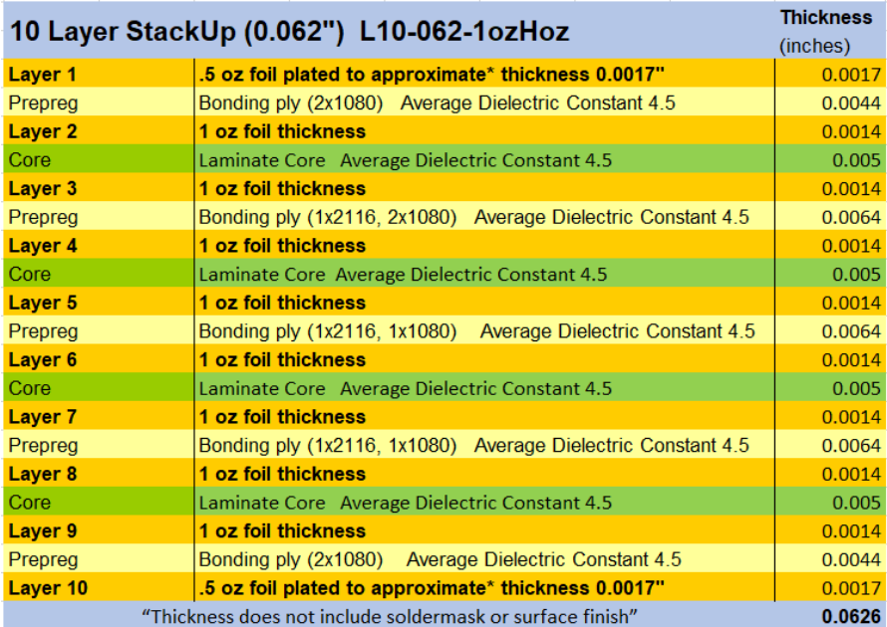
Layer Definition and Stack-Up
10 – Layer Board
Layer 1: Routing
Layer 2: Secondary Power RTN
Layer 3: Secondary Telemetry RTN and CUI Converter RTN
Layer 4: Secondary PWR IN
Layer 5: Secondary PWR RTN
Layer 6: Secondary Telemetry RTN
Layer 7: +2.5V Plane, CUI Input PWR
Layer 8: -5V Plane, CUI Input RTN
Layer 9: Secondary PWR RTN
Layer 10: Chassis GND
Board Fab House: Sunstone Circuits
Standard 10-Layer Stack up
Not expecting high currents or any high-speed signals

